Slide 1
Traffic sign detection and recognition system
By
Abhisatwika Reddy
Divyanshu Shekhar

Slide 2
Table of content
Introduction
Overview
Objective
Background Information
Definition of the Problem
Key Challenges
Flowchart
Methodology
Algorithms used
Result
Conclusion

Slide 3
INTRODUCTION
Traffic sign detection and recognition are crucial components for autonomous driving and advanced driver-assistance systems ,ensuring vehicles can navigate safely and comply with traffic rules. This project aims to develop a robust, real-time traffic sign recognition and detection system with enhanced accuracy and speed using advanced deep learning models. We employed Convolutional Neural Networks (CNN) trained on the GTSRB dataset for traffic sign classification and YOLOv9 with Spatial Attention trained on the Kaggle Traffic Sign Detection dataset for precise object detection. Additionally, we integrated the CNN model with an ESP32 camera to enable live video streaming and real-time traffic sign prediction, enhancing the practical application of the system in improving the safety and efficiency of autonomous driving.

Slide 4
Overview
The project aims to create a highly accurate and efficient traffic sign recognition and detection system to enhance autonomous driving. By training Convolutional Neural Networks (CNN) and YOLOv9 with Spatial Attention on different datasets ,we make comparison in robust classification and detection capabilities. The system is further enhanced with an ESP32 camera for real-time video streaming and immediate traffic sign prediction, offering a practical solution for improving vehicle safety and navigation.
OBJECTIVE
The objective of this project is to develop a highly accurate and efficient traffic sign recognition and detection system. By leveraging advanced deep learning models and real-time hardware integration, the system aims to enhance road safety and vehicle functionality. The project focuses on achieving robust classification and detection capabilities, addressing dynamic real-world conditions, and ensuring rapid, reliable traffic sign identification.

Slide 5
Background information
Traffic sign recognition and detection are essential for modern vehicle systems to navigate safely and sticky by traffic laws. Traditional methods, which relied on basic image processing techniques, often failed under varying conditions like poor lighting and occlusions. The advent of deep learning, particularly CNNs and object detection models such as YOLO, has greatly enhanced the precision and reliability of traffic sign detection. This project harnesses these advanced techniques to create a system that can perform real-time traffic sign recognition and prediction using an ESP32 camera, thereby addressing the limitations of earlier approaches and improving overall road safety.

Slide 6
DEFINITION OF THE PROBLEM
The primary challenge is to accurately detect and classify traffic signs in diverse and often challenging conditions, including variations in weather and lighting. Traditional methods for traffic sign recognition often struggle with these factors, leading to potential safety risks in autonomous driving and traffic management systems. To address these challenges, this project employs advanced deep learning models like Convolutional Neural Networks (CNNs) and YOLOv9 with spacial attention module, which excel in feature extraction and object detection. By leveraging these algorithms, we aim to enhance the system's ability to identify and classify traffic signs reliably across different environmental conditions. This involves data acquisition to train the models effectively, efficient feature extraction to capture relevant sign characteristics, and integration with an ESP32 camera for real-time application, ensuring traffic sign recognition on the road.

Slide 7
Key CHALLENGES
1. Environmental Variability: Coping with weather changes, varying lighting conditions, and potential obstacles that affect traffic sign visibility.
2. Sign Complexity: Handling the diverse shapes, colors, and sizes of traffic signs, which require robust detection and classification methods.
3. Real-Time Processing: Meeting the demand for quick decision-making in real-world scenarios while ensuring accuracy on hardware-constrained platforms.
4. Data Diversity: Acquiring comprehensive datasets that capture the full spectrum of traffic sign variations to train models effectively.
5. Hardware Integration: Integrating deep learning algorithms seamlessly with devices like the ESP32 camera for reliable real-time operation and prediction.

Slide 8
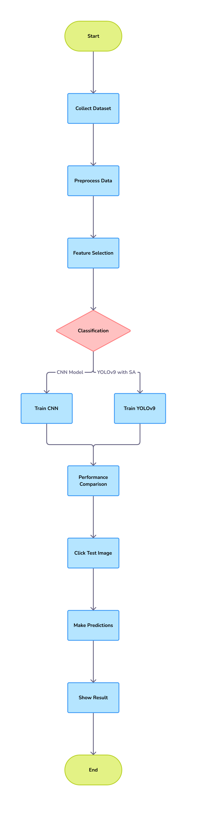
FLOWCHART
1. Collect Dataset: This step involves gathering a collection of images that will be used to train the CNN. The dataset should be labeled so that the CNN can learn to identify the different objects or concepts in the images.
2. Preprocess Data: The data preprocessing step involves preparing the images in the dataset for training. This may include resizing the images, normalizing the pixel values, and converting the images to a format that the CNN can understand.
3. Feature Selection: In this step, a subset of features is selected from the images. These features will be used by the CNN to classify the images.
4. Classification: The classification step is divided to 2 sub branches CNN model and YOLOV9 with special attention module
CNN Model : The flowchart then splits into two paths, which appear to be two different CNN models for classification.
YOLOv9 detection: This path trains a YOLOv9 detection model. YOLOv9 is a real-time object detection system that can identify multiple objects in an image.
5.Performance Comparison: Once both models are trained, their performance is compared on a test dataset. The test dataset is a set of images that the CNN has not seen before. The performance comparison helps to determine which model is more accurate for the task at hand.
6. Click Test Image: Here, a test image is clicked using ESP32 Camera to make predictions later
7. Make Predictions: Make predictions on test image clicked with trained CNN model.
8. Show Result: The results of the predictions are then displayed.

Slide 9
Methodology
Data Acquisition
Data acquisition involved gathering images from two main datasets: the German Traffic Sign Recognition Benchmark (GTSRB) dataset and the Kaggle Traffic Sign Detection (KTSR) dataset. The GTSRB dataset provided a wide range of traffic sign images with 43 different classes, while the KTSR dataset included diverse scenarios such as green lights, red lights, and various speed limit signs.
Preprocessing
Preprocessing prepares the data for training by standardizing image sizes, normalizing pixel values, and augmenting the dataset through techniques like rotation, translation, and flipping. This step ensures the model's robustness and generalization capability.
Feature Extraction
Feature extraction utilizes Convolutional Neural Networks (CNNs) to automatically learn and extract hierarchical features from traffic sign images. The CNN architecture is designed to capture both low-level features (such as edges and textures) and high-level semantic features (such as sign shapes and symbols).

Slide 10
Algorithms
- CNN Model: Trained on the preprocessed dataset to classify traffic signs into their respective categories.
- YOLOv9 with Spatial Attention: Used for object detection, particularly for real-time localization and classification of traffic signs in images.
Performance Inference
Performance evaluation involves comparing the accuracy, precision, recall, and F1 scores of both models on test datasets. Metrics such as inference speed and detection accuracy are crucial for assessing real-time performance and model robustness under varying conditions.
Hardware Integration with CNN Model
Integration with the ESP32 camera module enables real-time traffic sign recognition. The CNN model is optimized for deployment on resource-constrained hardware, ensuring efficient inference and reliable operation in practical applications.

Slide 11
Algorithms used
Convolutional Neural Network (CNN):
Performance: Achieved high accuracy in classifying traffic signs into 43 different classes. Evaluated on test datasets, the CNN model demonstrated robust performance in terms of accuracy metrics such as precision, recall, and F1 score.
YOLOv9 with Spatial Attention:
Performance: Evaluated for object detection accuracy and speed. The YOLOv9 model, enhanced with a Spatial Attention module, showed superior performance in detecting and localizing traffic signs in real-time video streams. It excelled in terms of speed and maintained high accuracy levels across diverse environmental conditions, crucial for applications requiring rapid decision-making.
Comparative Analysis:
The CNN model is efficient for quick training and generalization.
The YOLO model is superior for real-time applications requiring high accuracy and reliability.

Slide 12
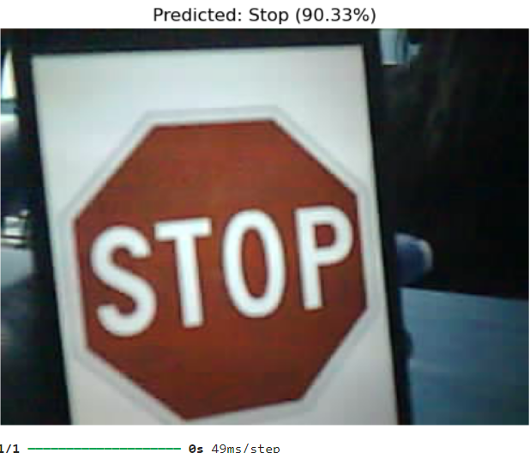
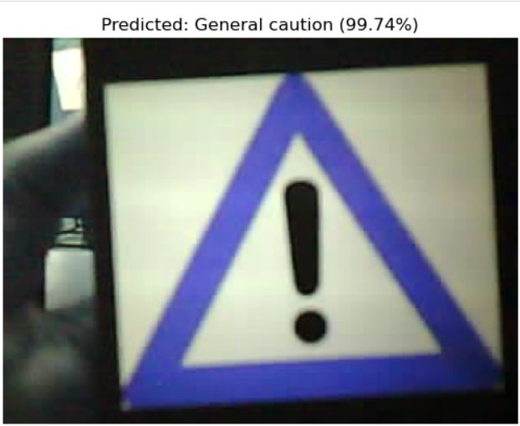
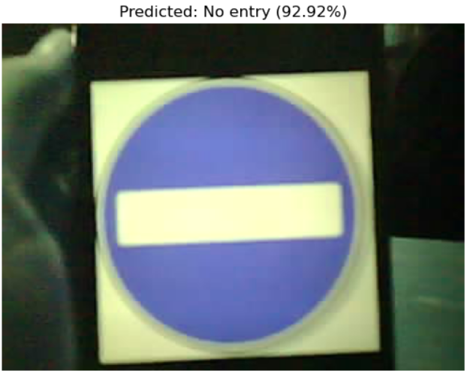
RESULT
For CNN Model

Slide 13
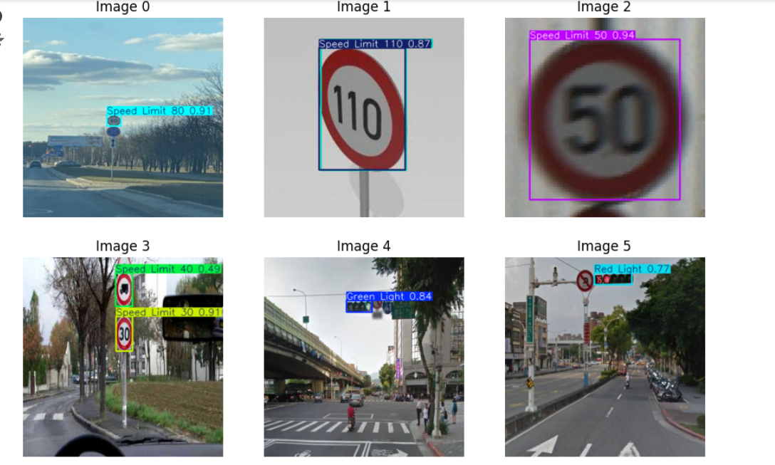
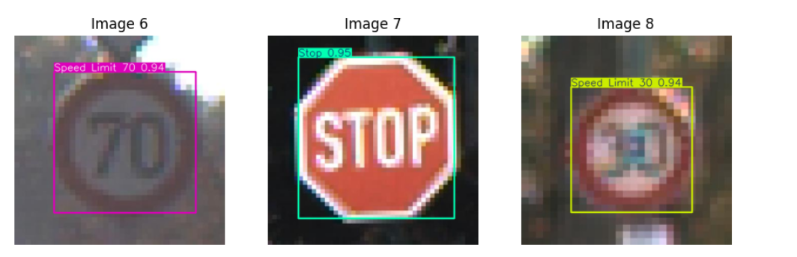
For YOLOV9 model
We made predictions on test data available in the dataset itself to identify model’s accuracy. It detected , made contour boxes around the relevant traffic signs and made correct predictions indicating model is just working fine.

Slide 14
Conclusion
In conclusion, our study focused on enhancing traffic sign recognition and detection using two main algorithms: a Convolutional Neural Network (CNN) for classification and YOLOv9 with Spatial Attention for real-time detection. The CNN excelled in accurately classifying traffic signs across diverse classes, while YOLOv9 demonstrated superior performance in fast and precise object detection in real-world scenarios. By leveraging these algorithms, we aimed to improve safety and efficiency in autonomous driving and smart transportation systems, showcasing their complementary roles in enhancing traffic management and driver assistance technologies.

Slide 15
Thankyou

